Slide 1
1
( Practical Molecular Biology
)
20 8 20 9
ؤ
1 -
1
ac R
lac.Raghad Ibrahim
l
.
Lab (7): Gel electrophoresis
This technique was discovered in the 1970s and has been replaced by the ultra-Centrifugal Sucrose Gradient technology.Its simple and important techniques in the separation, purification and definition of DNA and RNA
Gel Electrophoresis is a quick and simple method of separation and diagnosis and purification of our parts during Passed through the gel and used
1. To separate a mixture of DNA, RNA, and protein.
2. Calculate the molecular weight of molecules separated from the gel compared to a marker with a known molecular weight
1-Agarose Gel Electrophoresis (AGE) gel
The agrose gel used widly in this technique is a polysaccharide its derives from galactose , which are associated with the hydrogen bond to form a complex net. The pores depend on the concentration of the agarose, The concentration of
the gel is between 2 - 0.5 and 12 cm long, and the most commonly used "is 1 - 0.7%, which is used to separate large pieces of DNA with a molecular weight of 200bp -
20Kbp.
2-Polyacrylamide Gel Electrophoresis (PAGE)
Is a product of the binding of crystallized acryl amide with bis-acrylamide to form a complex network with smaller diameter holes than those found in the agarose gel.
For this reason, the acryl ammide gel is more suitable in separating our smaller parts,
200 bp - 1. The best concentration of acryl amide is 7.5%. However, the disadvantage of this type of gel is that it is more difficult and expensive compared to the agarose.
1. Agarose Gel Electrophoresis (AGE
The principle of this process depends on the passage of the particles through
the middle (field) electric have negative charges from one of the parties and the
charges of positive from the terminal and thus due to circular movement of the
electrode loads, so that the DNA molecule has the negative charge due to the
existence of the phosphate group their for the Wells e that the sample was put in it
must be in negative side, to attract negative towards positive, leading to their
separation according to molecular weight.
Materials & Equipments Required:
A. - Materials and devices required
1-Balance
2-Microwave
3-Power Supply
.4 Electrophoresis Tank
1

Slide 2
2
( Practical Molecular Biology
)
20 8 20 9
ؤ
1
-
1
ac R
lac.Raghad Ibrahim
l
.
.5 Tray of Gel
.6 UV – transilluminator
7-Digital Camera
.8 Comb
9-Compass
10-Para film
11 -Tape
12-scissors
13-Micropipette
14 -Tips
B. Chemical substances and solutions
1-Agarose
2- Electrophoresis Buffer
Which is called a solution TBE (Tris Borate EDTA) strength X10 This solution
consists of:( Tris-base molar 0.89, Boric Boric acid molar 0.89, EDTA pH 8 molar
0.02) 
Prepare 200 ml of X10 TBE solution by taking 21.6 g of Tris-base with 11 g of boric
acid and dissolving it in 160 ml distilled water, adding 10 of Na2EDTA solution at 0.4
mL concentration and pH pH to 7.8 then complete volume to 200 ml With distilled
water and sterilized with a crucible. At each use, it is diluted by adding a fraction of
distilled water to obtain TBE X1.
3- Loading buﬀer: X10
Prepare to dissolve 0.25 g of blue bromophenol dye in 50% calcirol and add EDTA
solution at a concentration,60 mM of pH 8.0 and complete the volume to 100 ml with
distilled water. And was saved at a level of 4 C.
4- Ethidium bromide: the dye of the ethidium bromide
Prepared at 10 mg / ml by dissolving 100 mg of dye powder in 10 ml of distilled
water and stored in a sterile vial at 4 ° C until use. At that time, 40 md / liter of
distilled water.
The flow of DNA across the agarose in an electrode field from the cathode to the
positive electrode is based on factors
a) Molecular weight of DNA:
The flow of DNA molecules depends on Molecular weight, and the DNA molecules
are linear, double or helix-shaped, thus different in molecular structure and weight
due to migration of DAN molecule inversely proportional to molecular weight.
b) Concentration of agarose:
2

Slide 3
3
( Practical Molecular Biology
)
20 8 20 9
ؤ
1 - 1
ac R
lac.Raghad Ibrahim
l
.
The speed of migration of similar molecules varies with the change in the
concentration of the agarose used for the separation process. Thus, a constant relationship exists between the logarithm migration M and the T-gel concentration, which is the relationship:
Logu = logm^{m}o – k_{r} – t
Where m represents the free speed of migration, and kr represents the Retardation
Coefficient
Molecular weight of linear DNA Concentration of ت
agarose %
5 – 60
0.3
1.
1 – 20
0.6
2.
0.8 – 10
0.7
3.
0.5 – 7
0.9
4.
0.4 – 6
1.2
5.
0.2 – 4
1.5
6.
0.1 - 3
2
7.
c) Structure of DNA:
Structural forms of DNA vary in their speed movement in the agarose
gel. Closed
Circular, Nicked Circular, Linear, with similar molecular weights, migrate In a specific
concentration of the agarose gel was different speed.
d) Power supply quantity:
The speed of the flow of linear DNA molecules is proportional to the amount of voltages used for electrophoresis. As the voltages increase to a certain degree, the flow of large-weight molecules will increase, so the phase separation of the acarose can be divided and improved using a current of 5 volts / cm 2.
e) Specific content of bases in DNA and temperature:
The electrolysis of the agarose gel is not affected by the DNA content of the
nitrogens base , but the acrylmide gel was affected, and the temperature change does not affect the speed of the migration. Migration is typically used to separate
the DNA molecules by the Horizontal gel, which provides the ability to use low
concentrations of agarose in the separation
C. MethodS
3

Slide 4
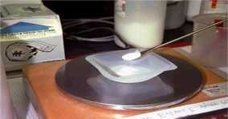
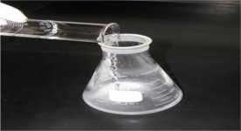
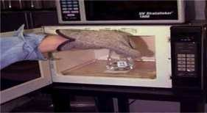
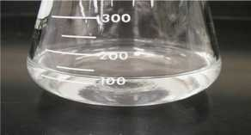
4
( Practical Molecular Biology
)
20 8 20 9
ؤ
1 -
1
ac R
lac.Raghad Ibrahim
l
.
1. Prepare the gel according to the tray capacity of the electrophoresis supplement , 1 g of agarose and put in a conical flask and then add 100 mL of Tris - Borate - EDTA buffer . For a two-minute period in microwave, the solution should be observed to be pure and watery, leaving for 3-5 minutes at room temperature to reach a temperature.
1-WIGHET agarose
2- Put on it buffer
3- Heating
4- appear watery and clear
4

Slide 5
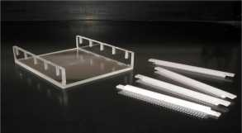
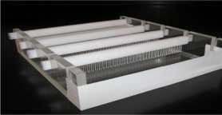
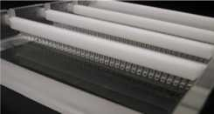
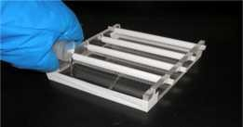
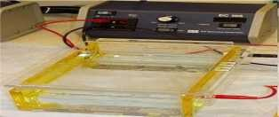
5
( Practical Molecular Biology
)
20 8 20 9
ؤ
1 -
1
ac R
lac.Raghad Ibrahim
l
.
2.
Preparation of Tray ; is well placed on a flat surface (table) and balanced
with the compass placed in the center of the tray. Comb is then placed in one
end of the tray and sometimes more than one comb is us ed at the same
time.
3.
gel casting: Gently pour the gel into the tray and prevent the bubbles
forming. If the bubbles are removed immediately by the end of the sterilize tip,
and leave to harden. After tightening, the comb is gently lifted vertically.
4.
Preparation of the tank:
The tank is placed on a flat surface and balanced by the same method. The tank
contains an intermediate base for placing the basin containing the gel. The tank is
fulling with a TBE buffer so that the gel is immersed in the solution. The tank is
provided with a lid, which is connected with the negative and positive electrodes on
one side and the other side Connect the electrodes with the Power Supply.
5

Slide 6
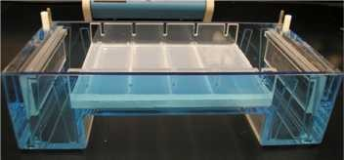
6
( Practical Molecular Biology
)
20 8 20 9
ؤ
1 -
1
ac R
lac.Raghad Ibrahim
l
.
5. Place the gel inside the tank:
The tray containing the gel shall be placed in the tank at its position. The TBE
solution shall cover the gel and the drilling shall be on the side of the cathode.
6.
1.
Preparation of the Aldena Model:
Take a piece of Para film and put it on the table top and fix it on the edges
using adhesive tape.
Put Loading Buffer to the Para film is added with a size of 7 to 3 times the
size of each sample and mixing well using the micropipette tip.
Remove the mixture completely using the same tip and transfer to the hole in the gel, taking into account the preparation of a map showing the location of the samples in the drill to ensure that the sampling places are not forgotten.
2.
3.
6

Slide 7
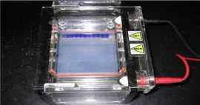
7
( Practical Molecular Biology
)
20 8 20 9
ؤ
1 -
1
ac R
lac.Raghad Ibrahim
l
.
7. Operation of the device:
1. Cover the tank properly to ensure the transfer from the negative pole to the positive pole. The power supply is operated on a voltage of 45 V and 180 Mili- amber for 15 minutes as a stage first.
After the end of 15 minutes we hear the alarm sound from the power supply,
adjust the voltages to 80 V and 180 Miliamber for 1 hour
The migration process is monitored by the movement of the Bromophenol blue dye as an indicator.
2.
3.
8-pigmentation:
1.
At the end of electrophoresis , the power supply is switched off first. The tray
is gently lifted and gently transferred to another tank containing the Ethidium
Bromide dye, where the gel is placed inside
Ensure that the gel is not broken for an hour and caution when dealing with this dye wearing thick gloves as a Carcinogenic. The advantage of this dye is its ability to bind to the double DNA molecule rather than to the single strand RNA.
After the dyeing time is finished, gently transfer the gel from the dyeing tank
to the UV-Transiluminator Stage.
Due to the association of Ethidium Bromide dye with DNA molecules and their ability to shine when exposed to radiation
UV We notice the presence of pink balloon packages, which are DNA
packages, we take a picture of the gel using any kind of cameras for the
purpose of documenting this image and keep it
4.
2.
3.
5.
7

Slide 8
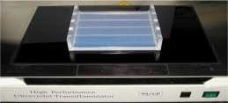
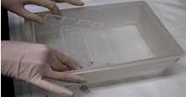
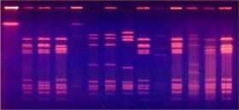
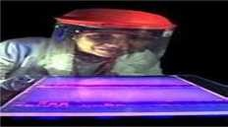
8
( Practical Molecular Biology
)
20 8 20 9
ؤ
1
-
1
ac R
lac.Raghad Ibrahim
l
.
8

